Slide 1

ENGINEERING CHEMISTRY
Asha A
Department of Science and Humanities

Slide 2

ENGINEERING CHEMISTRY
Module 6- Corrosion Chemistry
Class content:
Corrosion control
Inorganic coating
Anodising
Phosphating
Organic coating

Slide 3
ENGINEERING CHEMISTRY
Module 6- Corrosion Chemistry
Corrosion Control
Protective coating
Metallic coating
Inorganic coating
Corrosion Inhibitors
Anodic Inhibitors
Cathodic Inhibitors
Cathodic protection
Sacrificial Anode method
Impressed cathodic current method
Organic coating
Anodic Protection
Impressed anodic current method

Slide 4
ENGINEERING CHEMISTRY
Module 6- Corrosion Chemistry
Protective coatings:
Metallic coating:
Corrosion of base metal is prevented by coating a layer of another metal over it
Metal coated may be anodic or cathodic to the base metal
Anodic metal coating:
Coating of a layer of metal which is anodic to base metal
e.g. , Iron article coated with Zinc
Cathodic metal coating:
Coating of a layer of metal which is cathodic to base metal
e.g. , Iron article coated with Tin

Slide 5
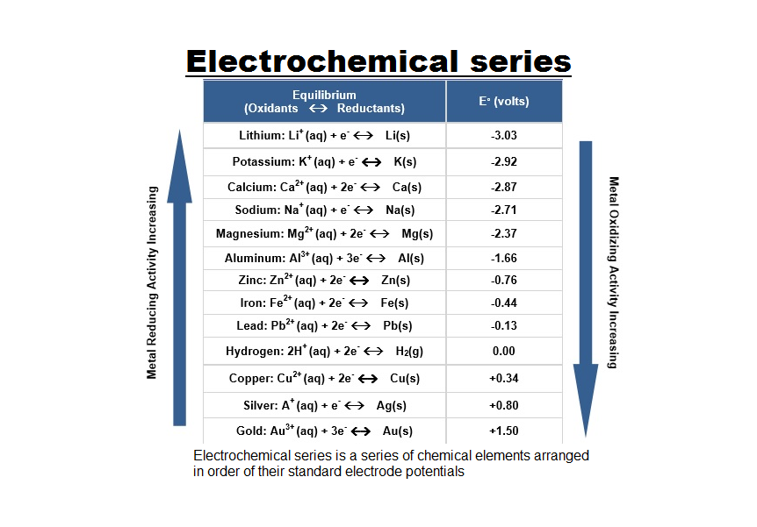

Slide 6
ENGINEERING CHEMISTRY
Module 6- Corrosion Chemistry
Anodic metal coating:
Coating metal is more active with respect to the base metal
Even if the base metal is not completely covered, it will not undergo pitting corrosion
e.g., Coating of Zn or Mg on iron

Slide 7
ENGINEERING CHEMISTRY
Module 6- Corrosion Chemistry
Galvanizing:
Coating a layer of zinc on iron is called galvanization
The following steps are involved in the process:
Iron sheet is passed through organic solvent or caustic solution to remove oil or grease present on it
It is washed with dil. H₂SO₄ to remove any rust, scale or dust present on the surface (pickling)
It is treated with a mixture of aqueous solution of ZnCl₂ and NH₄Cl which
acts as flux which prevents oxidation and then dried
Finally it is dipped in molten zinc at 425-430º C
Excess zinc present on iron sheet is removed by passing through hot rollers

Slide 8
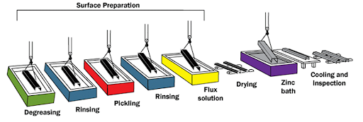
ENGINEERING CHEMISTRY
Module 6- Corrosion Chemistry
Process of Galvanisation
Source:http://www.lightsoftuscany.com/faq-page/faq-galvanization.html

Slide 9
ENGINEERING CHEMISTRY
Module 6- Corrosion Chemistry
Application:
Galvanization of iron is carried out to produce roofing sheets, fencing wire, buckets, bolts, nuts, pipes etc
Advantage:
Even if the Zn coating peels off or there are gaps at some places, the base metal (Fe) does not get corroded because the base metal acts as cathode
Galvanized articles are not used for preparing and storing food because zinc dissolves in dilute acids producing toxic zinc compounds
Disadvantage:

Slide 10
ENGINEERING CHEMISTRY
Module 6- Corrosion Chemistry
Inorganic coating
Referred to as chemical conversion coating
Surface of the base metal is converted into a protective coating through appropriate chemical modification
The protective film (corrosion product) is an inherent part of the metal
Two methods: Anodising and Phosphating
M

Slide 11
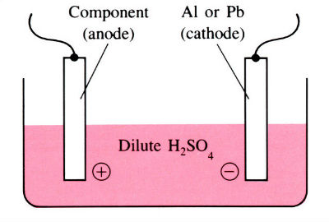
ENGINEERING CHEMISTRY
Module 6- Corrosion Chemistry
Anodizing:
Induced oxidation in an oxidising environment by making the article anode and passing current
Oxidation of outer layer of metal to its metal oxide which covers the metal surface and acts as protective layer
Done for non-ferrous metals like Al, Cr, Ti
Source:https://www.open.edu/openlearn/science-maths-technology/engineering-technology/manupedia/anodising

Slide 12
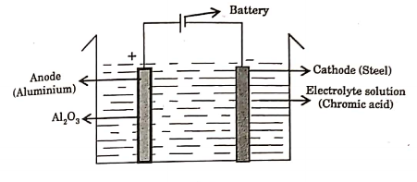
ENGINEERING CHEMISTRY
Module 6- Corrosion Chemistry
Anodizing of Aluminum:
The process:
Article is cleaned, degreased, and polished and taken as anode
It is immersed in an electrolyte consisting of 5-10% chromic acid, sulfuric
acid, phosphoric acid, oxalic acid or their mixtures maintained at around
40º C
Lead or steel is taken as cathode
Voltage above 40V is applied
Outer layer of Al is oxidised to Al₂O₃
2Al + 3H₂O → Al₂O₃ +3H₂
Source: Basuchandra’s Engineering chemistry, Banbayalu (2014)

Slide 13
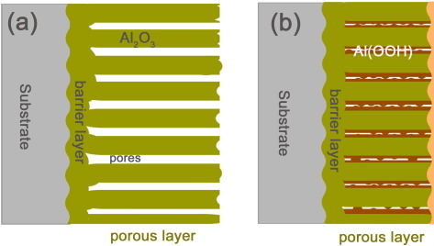
ENGINEERING CHEMISTRY
Module 6- Corrosion Chemistry
Al₂O₃ formed on the surface is slightly porous in nature
The porous layer may be made compact by sealing which is done by immersing the anodised article in boiling water or steam
Al₂O₃ is converted into Al₂O₃.H₂O which occupies higher volume; the pores are sealed
Source:https://www.sciencedirect.com/science/article/abs/pii/S0257897215304540

Slide 14
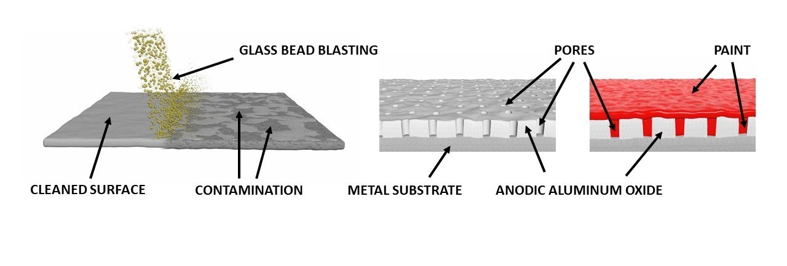
ENGINEERING CHEMISTRY
Module 6- Corrosion Chemistry
Anodized articles can produced in good colour finishes by
Adsorbing an organic dye after anodising and then sealing
Depositing a metal like Ni, Co etc., into the pores
Applications:
Anodized Al is used as an attractive, highly durable, corrosion resistant material in exteriors for roofs, walls, buildings and also in window frames, office partitions, tiffin carriers, etc.
Source:https://www.youtube.com/watch?v=w1cKVbtpE1E

Slide 15
ENGINEERING CHEMISTRY
Module 6- Corrosion Chemistry
Phosphating:
Converting the surface metal atoms into their phosphates by chemical or electrochemical reactions
Originally phosphate coating was applied only on Ferrous alloys like Fe and steel. But now it has been extended, to Zn, Al and their alloys
Chemical phosphating is done by dipping the article in a phosphating bath
In electrochemical phosphating, the process of electrolysis is used

Slide 16
ENGINEERING CHEMISTRY
Module 6- Corrosion Chemistry
Chemical Phosphating:
The process -
The phosphating bath contains three essential components:
Free phosphoric acid which reacts with the metal surface
Metal phosphates of zinc and manganese which increase adherence and decrease porosity of the coatings
An accelerator such as nitrites, chlorates, peroxides, etc. which speed up the reaction
The process is carried out at a pH of around 3 and a temperature of
35-40ºC
The reaction include dissolution of metal as ions, forming a phosphate with the bath solution which subsequently gets a deposited on the surface of
the metal
3Fe + 2H₃PO₄ → Fe₃(PO₄)₂↓ + 3H₂

Slide 17
ENGINEERING CHEMISTRY
Module 6- Corrosion Chemistry
Phosphate coatings are porous and themselves do not provide appreciable corrosion resistance
They are useful mainly as a base paints and imparts good paint adhesion quality
Phosphate coatings are very thin (3µm) and being porous interlock the paints onto the surface
Applications:
Phosphate coating is a pretreatment before painting the automobile bodies, refrigerators and washing machines

Slide 18
ENGINEERING CHEMISTRY
Module 6- Corrosion Chemistry
Organic coating:
Coating of metal surfaces with organic materials, particularly paints and lacquers is the most widely used anti corrosion coatings
The coatings serve to keep out air and moisture from the metal surface or serve as a barrier between the metal surface and the corrosion environment

Slide 19
ENGINEERING CHEMISTRY
Module 6- Corrosion Chemistry
Class content:
Corrosion control
Corrosion inhibitors
Anodic corrosion inhibitors
Cathodic corrosion inhibitors

Slide 20
ENGINEERING CHEMISTRY
Module 6- Corrosion Chemistry
Corrosion Inhibitors
Chemical substances which are added in small quantities to the corrosive environment to decrease the rate of corrosion
Inhibitors slow down or inhibit the anodic or cathodic reaction and control corrosion
They can be used only in confined environment
The action of an inhibitor depends on the nature of the metal to be protected as well as corrosive environment
Corrosion inhibitors
Anodic inhibitors
Cathodic inhibitors

Slide 21
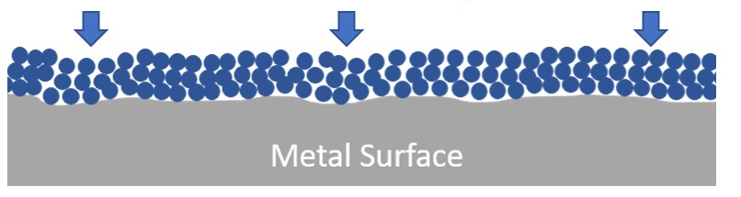
ENGINEERING CHEMISTRY
Module 6- Corrosion Chemistry
Anodic inhibitors:
M → M^{n+} + ne⁻
If the formation of M^{n+} is prevented, the corrosion process is retarded
This is achieved by the addition of large anions such as chromate(CrO₄²), tungstate (WO₄²), etc.
These ions combine with M^{n+} and form a precipitate which covers the surface of the anode
Source:http://www.penriteoil.com.au/knowledge-centre/Coolant%20Inhibitor%20Packs/149/what-are-corrosion-inhibitors/289

Slide 22
ENGINEERING CHEMISTRY
Module 6- Corrosion Chemistry
Anodic inhibitors are found to be effective only when sufficient amount of the inhibitor is added into the corrosion medium
If insufficient quantity is added, then a part of the anodic region is exposed to the environment
Formation of small anodic area results in intense corrosion
Salts like Na₂CrO₄ , Na₂WO₄

Slide 23
ENGINEERING CHEMISTRY
Module 6- Corrosion Chemistry
Cathodic inhibitors:
liberation of hydrogen
absorption of oxygen
Inhibiting any of these reactions will slow down the cathodic reaction which in turn slows down the anodic reaction; corrosion is inhibited

Slide 24
ENGINEERING CHEMISTRY
Module 6- Corrosion Chemistry
Inhibition of hydrogen liberation:
Preventing the diffusion of H⁺ ions to the cathode-
By the addition of certain organic compounds which contain nitrogen or sulfur
Aliphatic amines, urea, thiourea, mercaptans, heterocyclic compounds are widely used as cathodic inhibitors
They get adsorbed on the cathodic region forming a protective film, preventing the H⁺ ions from coming in contact with the cathodic metal surface

Slide 25
ENGINEERING CHEMISTRY
Module 6- Corrosion Chemistry
By increasing the hydrogen overvoltage on the metal
surface –
When Hydrogen overvoltage is high , liberation of H₂ will be
difficult
By the addition of oxides of arsenic, antimony(As₂O₃, Sb₂O₃)
or salts like sodium meta-arsenite(NaAsO₂)
They deposit on the cathode region
The hydrogen overvoltage on these metals is very high; liberation of H₂ is reduced

Slide 26
ENGINEERING CHEMISTRY
Module 6- Corrosion Chemistry
Inhibition of oxygen absorption:
By removing the oxygen from the corrosive media -
By adding Oxygen scavengers like hydrazine
N₂H₄ + O₂ → N₂ + 2H₂O
By adding reducing agents sodium sulfite etc.
2Na₂SO₃ + O₂ → 2Na₂SO₄

Slide 27
ENGINEERING CHEMISTRY
Module 6- Corrosion Chemistry
By decreasing the diffusion rate of oxygen to cathode –
By adding salts with large cations such as ZnSO₄, MgSO₄, NiSO₄ etc.
The cations of the salts (Zn²⁺, Mg²⁺) migrate towards the cathode surface and react with the hydroxyl ions formed at the cathode
Zn²⁺ + 2OH⁻ → Zn(OH)₂
Mg²⁺ + 2OH⁻ → Mg(OH)₂
The hydroxides get deposited on the cathodic sites
The protective film impermeable to oxygen prevents its diffusion to the cathodic region

Slide 28
ENGINEERING CHEMISTRY
Module 6- Corrosion Chemistry
Limitations:
They contaminate the environment
Many of the inhibitors are toxic, cannot be used in systems which come in contact with humans
Can be used only in closed systems in which corrosive environment is either contained or re-circulated

Slide 29
ENGINEERING CHEMISTRY
Module 6- Corrosion Chemistry
Class content:
Corrosion control
Cathodic protection
Sacrificial anode method
Impressed cathodic current method

Slide 30
ENGINEERING CHEMISTRY
Module 6- Corrosion Chemistry
Cathodic protection:
By converting it completely into cathode and no part of it is allowed to act as anode
Cathode does not undergo corrosion so the structure is protected
Cathodic protection
Sacrificial anode method
Impressed current method

Slide 31
ENGINEERING CHEMISTRY
Module 6- Corrosion Chemistry
Sacrificial anode method:
In this method, protected metal structure is converted into a
cathode by connecting it to a more active metal
This active metal (example: zinc, magnesium) acts as
an auxiliary anode
These metals being more active, acts as anode and undergo
preferential corrosion, protecting the metal structure
Since the anodic metals are sacrificed to protect the metal
structure, the method is known as sacrificial anode method
Exhausted anodes have to be replaced periodically

Slide 32
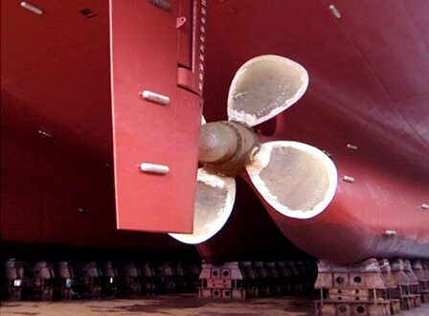
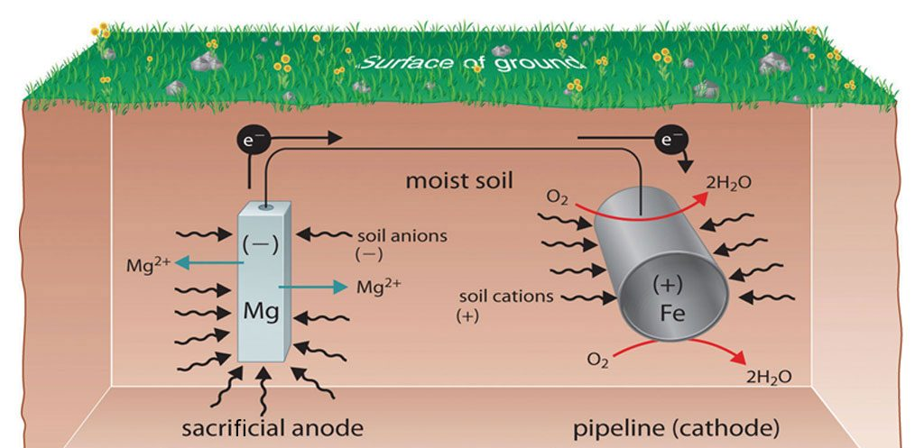
ENGINEERING CHEMISTRY
Module 6- Corrosion Chemistry
Examples:
Mg/Zn bars are fixed to the sides of ocean going ships to act as sacrificial anodes
Mg/Zn blocks are connected to buried pipe lines
A Mg block connected to a buried oil storage tank
Source:https://thenavalarch.com/ship-corrosion-cathodic-protection-sacrificial-anodes/
Source:https://www.pipelineprotection.co.uk/services/cathodic-protection/

Slide 33
ENGINEERING CHEMISTRY
Module 6- Corrosion Chemistry
Advantages:
The method is simple
Low installation cost
Does not require power supply
Disadvantages:
Involves recurring expenditure for replacement of consumed
anodes

Slide 34
ENGINEERING CHEMISTRY
Module 6- Corrosion Chemistry
Impressed current method:
By applying a direct current
The protected metal is made cathodic by connecting it to the cathode
of the external source of current
Anode of the external source is usually connected to an inert electrode
like graphite; Platinum, silicon, iron are also used as anodes
A backfill of coke ,bentonite is used to improve efficiency of the anode
The metal structure being cathode does not undergo corrosion
Anode being inert remains unaffected

Slide 35
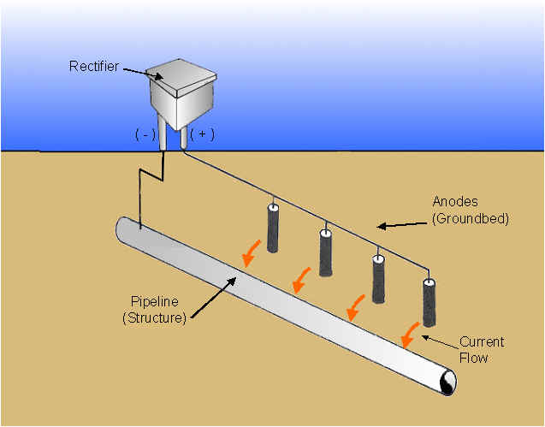
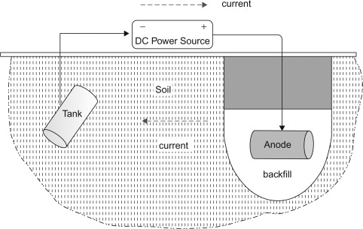
ENGINEERING CHEMISTRY
Module 6- Corrosion Chemistry
Source:https://www.mcwaneductile.com/blog/v-bio-r-or-cathodic-protection-an-honest-comparison/
Source:https://www.sciencedirect.com/topics/engineering/impressed-current-system

Slide 36
ENGINEERING CHEMISTRY
Module 6- Corrosion Chemistry
Advantages:
One installation can protect large area of metal
Limitations:
Rather expensive, since it needs high current for safe protection of structure
If the impressed current is not uniform on the entire surface of the protected structure, localized corrosion takes place on the protected metal

Slide 37
ENGINEERING CHEMISTRY
Module 6- Corrosion Chemistry
If hydrogen liberation is the cathodic reaction on the metal surface, then the protected metal may suffer from hydrogen embrittlement
Hydrogen embrittlement:
H₂ molecule being small enters the metal lattice and when the pressure increases , it causes blisters and makes the metal brittle

Slide 38
ENGINEERING CHEMISTRY
Module 6- Corrosion Chemistry
Class content:
Corrosion control
Anodic Protection
Impressed current method

Slide 39
ENGINEERING CHEMISTRY
Module 6- Corrosion Chemistry
Anodic protection:
Prevention of corrosion by impressed anodic current is called as anodic protection
The article to be protected is made anode by connecting it to the anode terminal of the power source
Can be used only for metals which show active-passive behaviour like nickel, iron, chromium, titanium and their alloys
On applying an optimum potential these metals get passivated and rate of corrosion decreases

Slide 40
ENGINEERING CHEMISTRY
Module 6- Corrosion Chemistry
Active – passive transition of metals with the application of a potential can be explained from the potential-current curve
Transpassive region
Passive region
E
E_{p}
i_{passive}
i_{crit}
log i

Slide 41
ENGINEERING CHEMISTRY
Module 6- Corrosion Chemistry
A known potential is applied to the metal specimen and current is measured
As the potential is increased, initially the current also increases, and it indicates the dissolution of metal
This trend continues until the current reaches a critical value (i_{crit}) and passivation due to the development of oxide layer sets in
The potential required for the passivation due to the development of oxide layer, this potential called passivating potential (E_{p})
Transpassive region
Passive region
E
E_{p}
i_{passive}
i_{crit}
log i

Slide 42
ENGINEERING CHEMISTRY
Module 6- Corrosion Chemistry
Above Ep, the current flow decreases and reaches a minimum value called passivation current, i_{passive}
If the potential is increased further, the metal remains unattacked up to a particular potential is reached. In this range, corrosion rate of the metal is very small. This potential range, in which anodic potential can be achieved, is called passive region
If the potential is increased further, corrosion rate increases and this region is called the transpassive region
The optimum potential for protection is determined by electrochemical measurements
Transpassive region
Passive region
E
E_{p}
i_{passive}
i_{crit}
log i

Slide 43
ENGINEERING CHEMISTRY
Module 6- Corrosion Chemistry
Anodic protection to a structure is applied by using a device
called potentiostat
It is an electronic device that maintains a metal at a constant potential with respect to a reference electrode
Potentiostat has three terminals, one connected to the anode, another to an auxillary cathode(Pt) and the third connected to a reference electrode

Slide 44
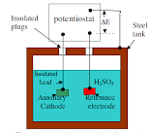
ENGINEERING CHEMISTRY
Module 6- Corrosion Chemistry
Anodic protection of a steel tank carrying H₂SO₄
One terminal is connected to the storage tank(anode)
Other is connected to the reference electrode and a constant potential corresponding to the passive range is maintained between tank and the reference electrode
The third terminal is connected to an auxiliary electrode like Pt
Source:https://uomustansiriyah.edu.iq/media/lectures/5/5_2016_04_20!11_15_38_AM.pdf

Slide 45
ENGINEERING CHEMISTRY
Module 6- Corrosion Chemistry
Advantages:
Applicability in extremely corrosive environments
Low current demand
Disadvantages:
Restricted to metals that show active-passive behaviour
Initial installation cost is high
Cannot reduce corrosion rate to zero unlike cathodic protection

Slide 46
THANK YOU
Asha A
Department of Science and Humanities

